Slide 1

Course Management System
Notes:
Hi Everyone,
Good Morning
Before we start with the presentation today, I would like to share a small recital.
We have been a part of Publicis Sapient for almost 3months now, and there is this fact that everyone of us would agree upon.
We all started as fresh graduates, underwent 5weeks or so of rigorous training followed by what…5 weeks now of a Hands On project, and what has transpired in these days is a fact that we all are really proud of. A transformation from someone who could code, to someone who can not only code, but add value to everything he does.
So have we succeeded at becoming a Product engineer?
Hi, I am Rajat, a small part of our big team here.
I am here with my colleagues Aman and Chinmay and we are here to give you a walkthrough of our Transformation, our Journey and the project we have been working for sometime now.

Slide 2
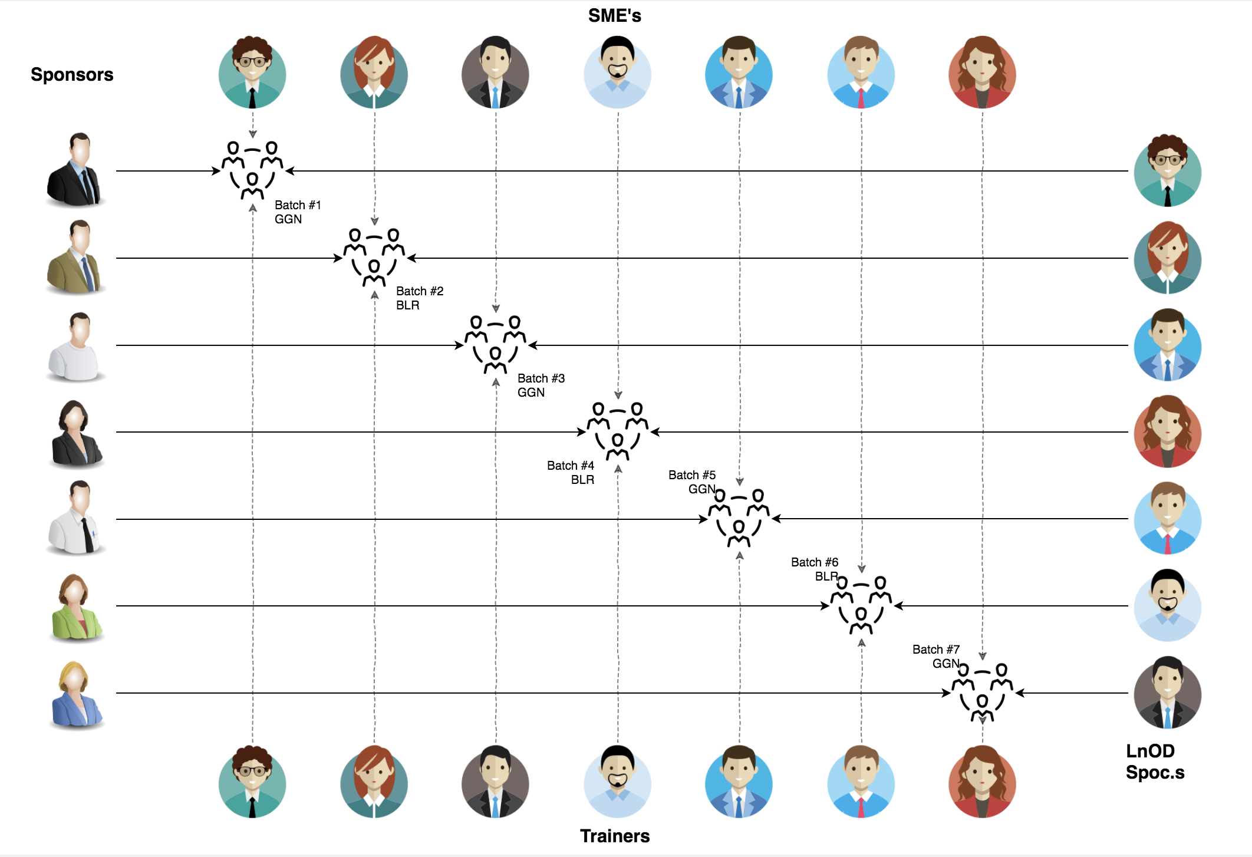

Stakeholders
Sponsors
Flipkart
2. SME’s
Amit Balyan
3. Coordinators
Anushka Khanna

Slide 3

Agenda
01
Our Journey
02
Our Team
03
Team Structure
04
Problem Statement
05
Engineering Practices
06
Tech Stack
07
Challenges & Learnings
08
Demo

Slide 4

Our Journey

Slide 5
ACTION PLAN
 | Modules | Description
DAY 1 | UNIX GIT UML Diagrams | Understanding commands of Unix and Git Understanding Problem Statement
DAY 2 | JAVA | Identifying all the classes and their corresponding member functions
DAY 3 | I/O and Collections Framework | Developing a POS application using I/O and containers of collections framework.
DAY 4 | Interface and JDBC API | Implementing all interfaces for method declaration and using JDBC API to connect with MySQL Database.
DAY 5 | Exception Handling | Implementing all interfaces for method declaration and using JDBC API to connect with MySQL Database.
DAY 6 | Dropwizard | Transforming the POS application in Dropwizard development Replacing Client Menu with the REST controller.

Slide 6
Demo
Testing
Process
5
project Demo
Tools
4
Testing on Console, REST client such as Postman
Comprehend
3
Architecture Design and Development
2
Decide the Technology stack for console and REST API development
1
Understanding Project Requirements and Goals

Slide 7

OUR TEAM

Slide 8
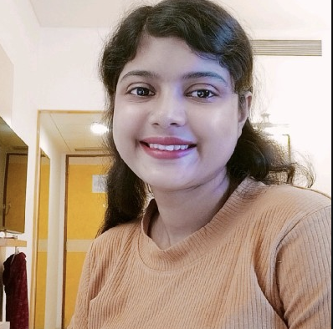
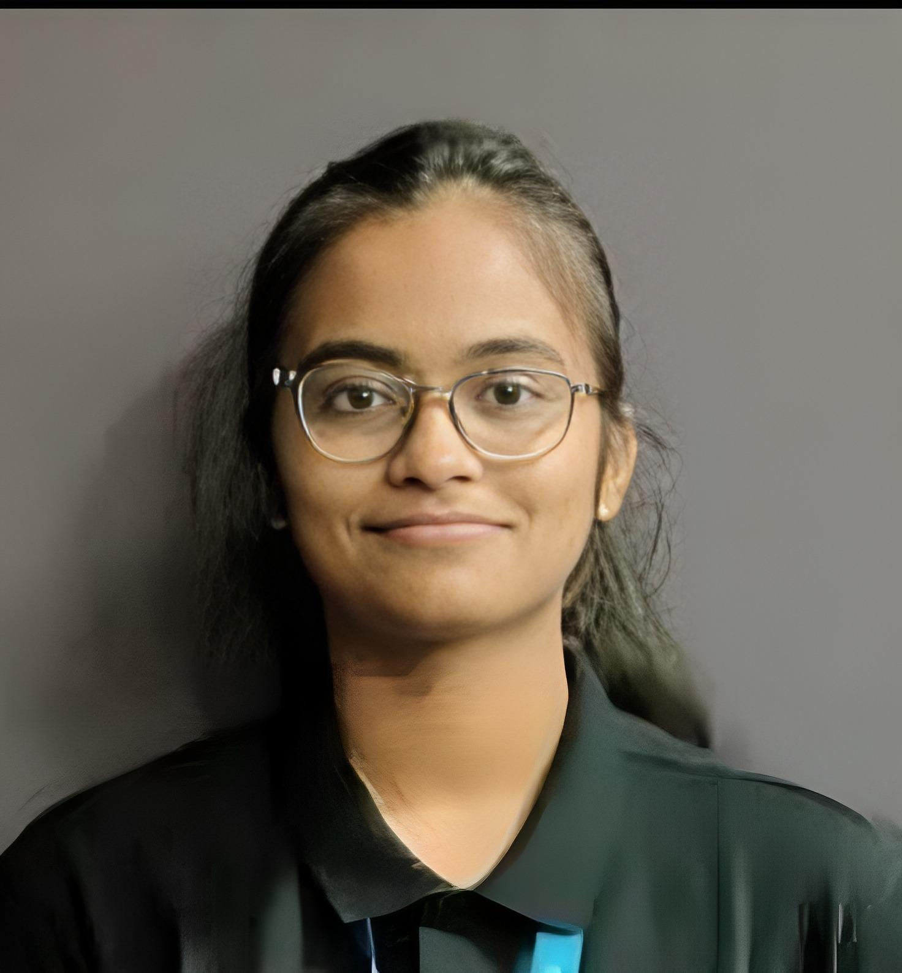
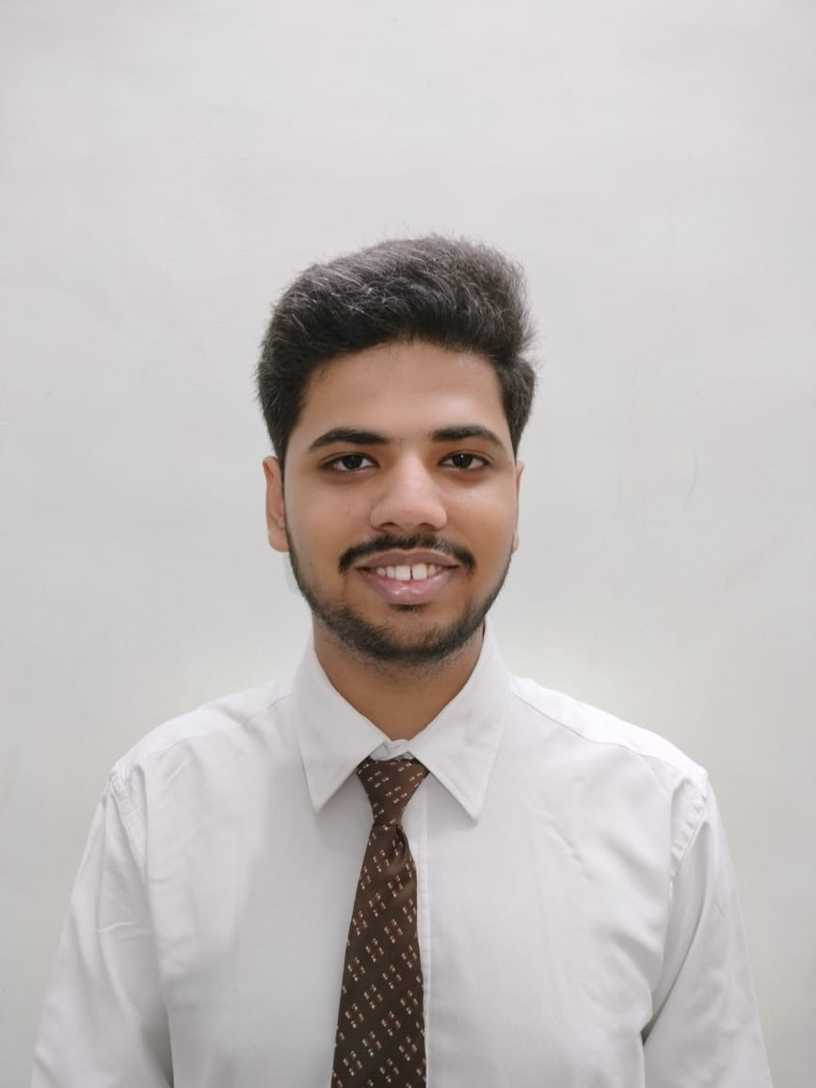
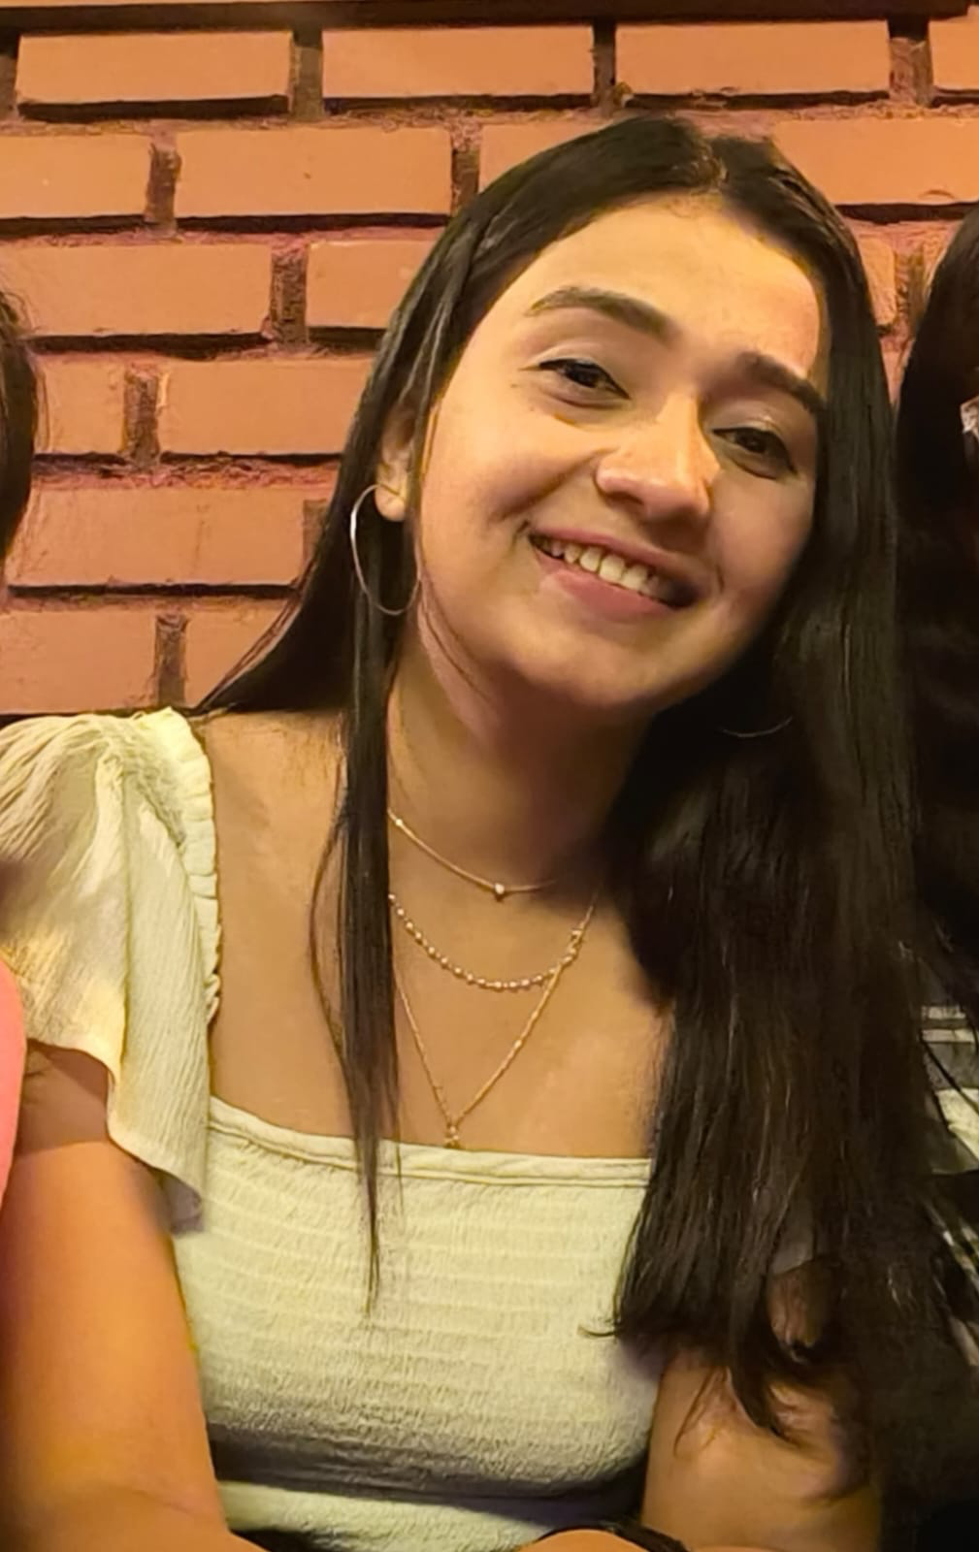
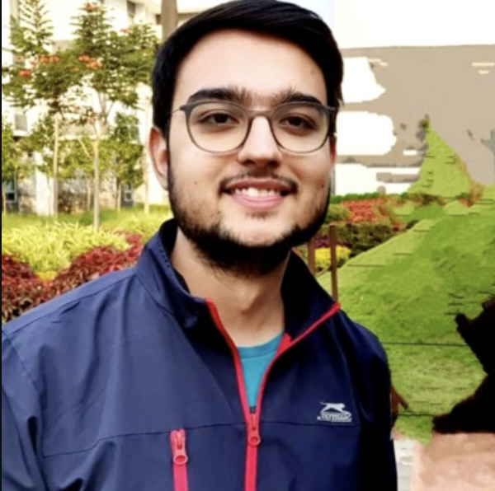
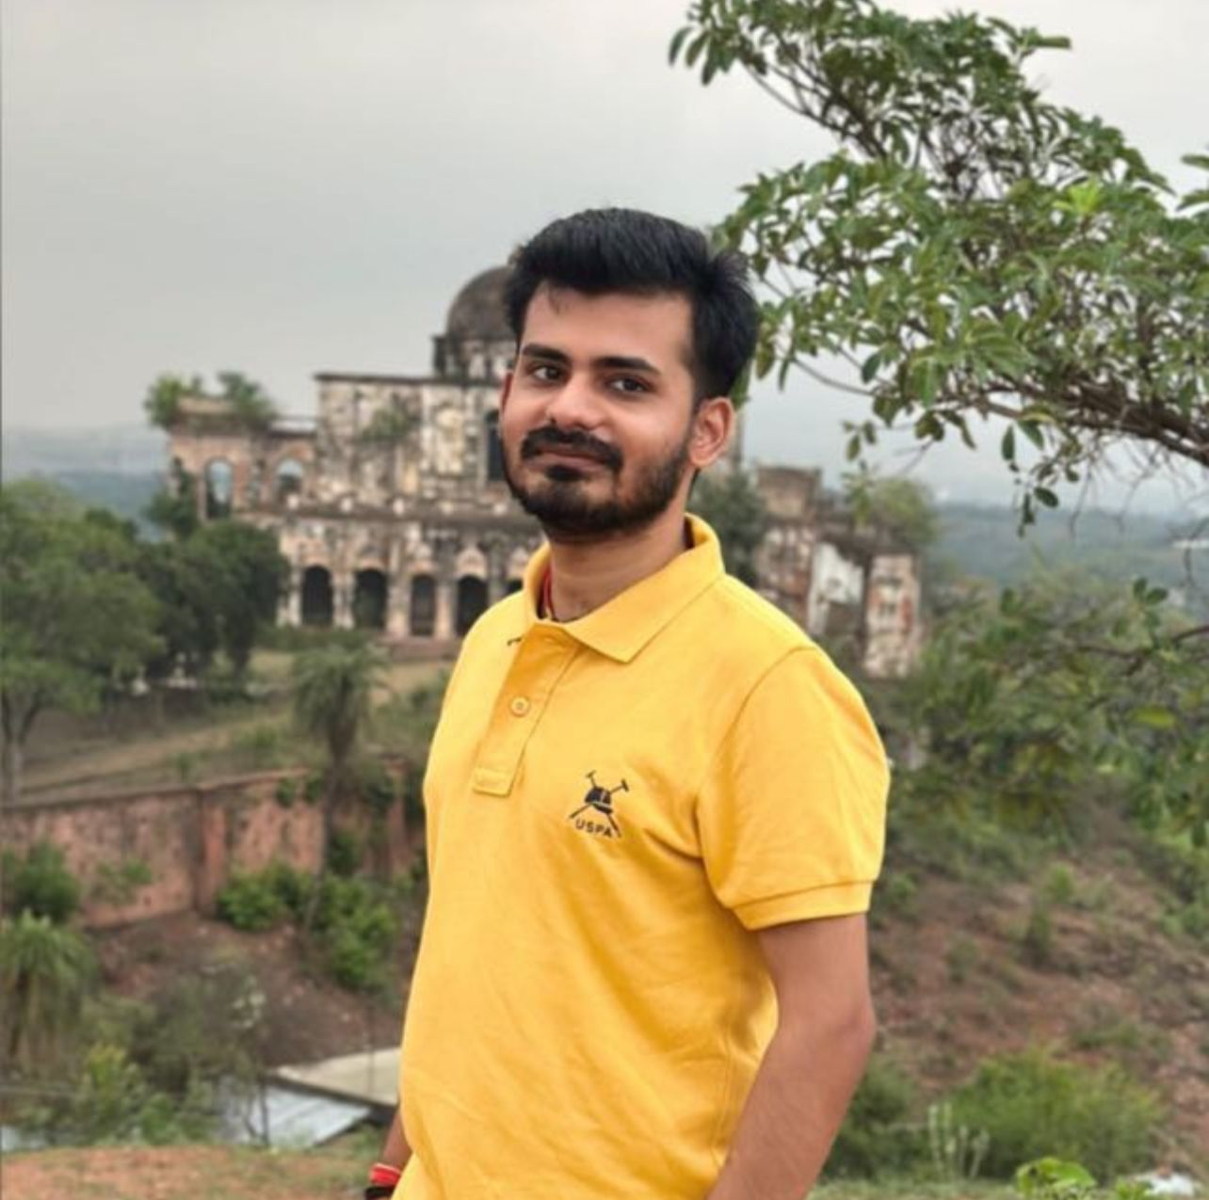
Divya Porwal
Tanisha Prafulbhai Shah
Rhythm Vinay Chouhan
Reshma Panigrahi
Ritish Sachdeva
Suman Chandra

Slide 9
Team Structure
Name | Responsibility
Divya Porwal | Implemented Professor, User functionalities Use Case Diagrams
Suman Chandra | Implemented Professor, User functionalities Use Case Diagrams
Rhythm Vinay Chouhan | Implemented Student, User functionalities Sequence Diagrams
Tanisha Prafulbhai Shah | Implemented Student, User functionalities Sequence Diagrams
Ritish Sachdeva | Implemented the documentation of the entire codebase.
Reshma Sanatan Panigrahi | Implemented Admin functionalities Class Diagrams

Slide 10

Problem Statement

Slide 11




Problem Statement
To develop a POS application and REST API for Course Registration System using JAVA where the student can register, add/drop course, professors can view courses, enrolled students while admin can manage users, add/drop courses to catalog
1
2
Quality
Security
3
4
Interactivity
Speed

Slide 12

Engineering Practices

Slide 13
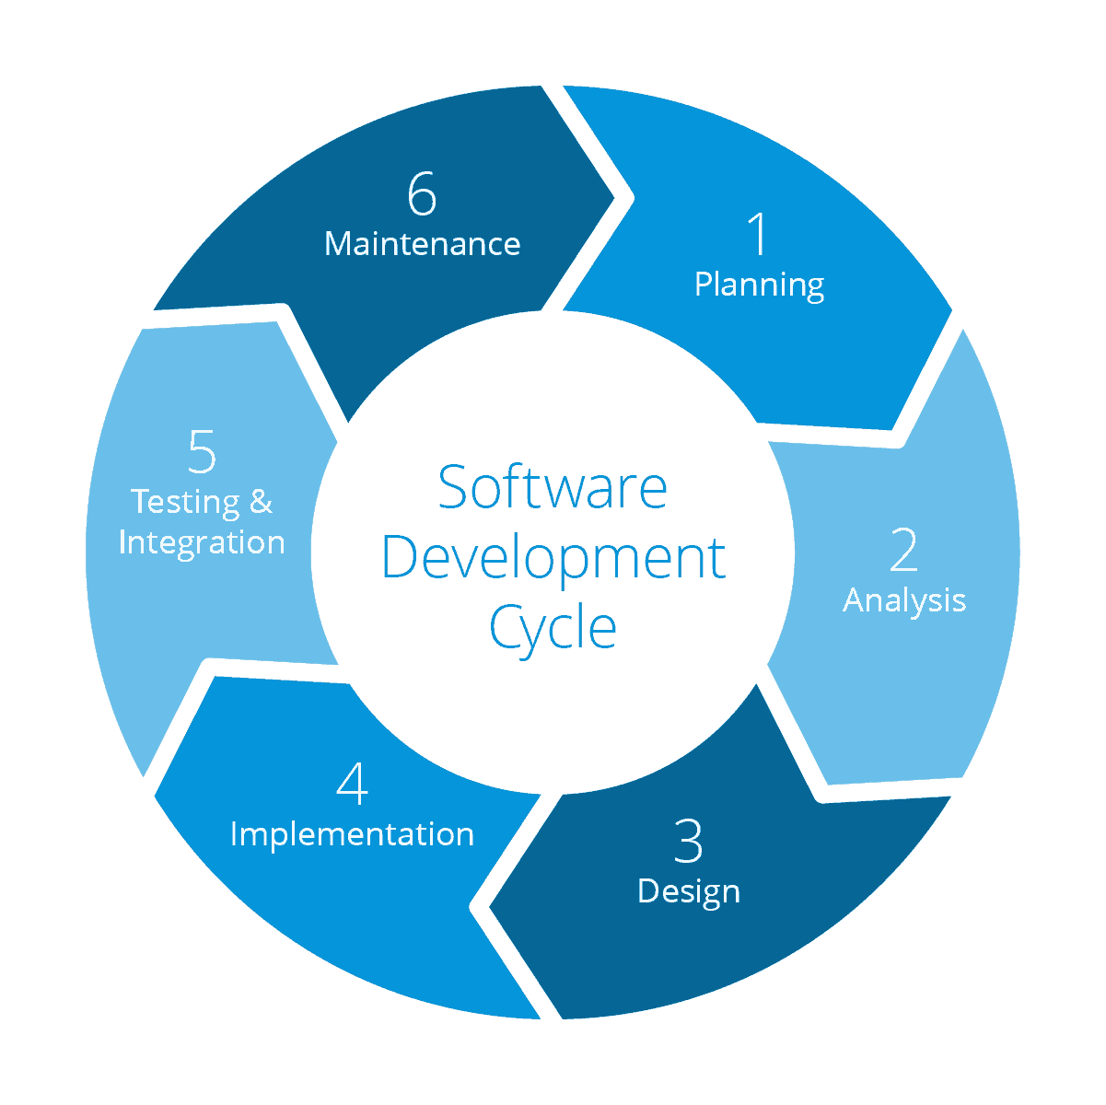
Requirement Gathering
Tech Stack Selection
UML Artifacts, Architecture Design
Code development

Slide 14
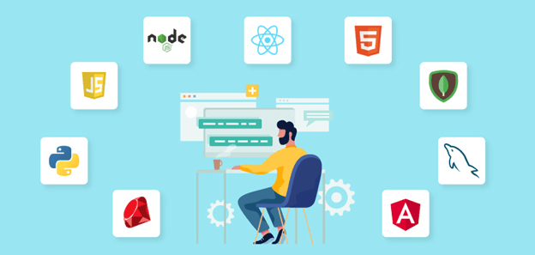
Tech Stack

Slide 15



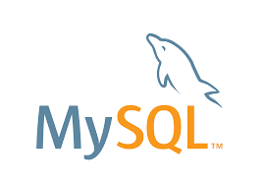


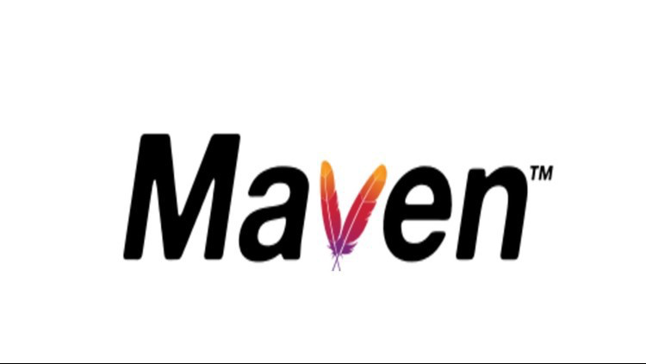


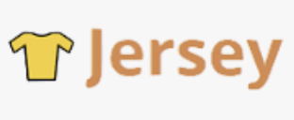
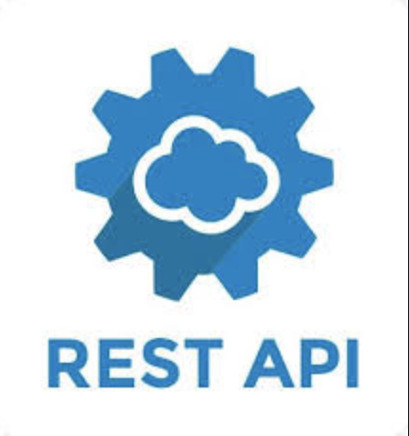
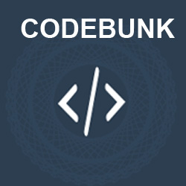
Designing
Backend
Testing
Data
SCM
UML
Core Language
Tools
SQL Database
Code Collaboration
Framework
Application Server

Slide 16

Architecture Design
Notes:
Time – 1 min

Slide 17

POS Application
Java Main Client
Business Code
Database Code
HTTP Request
HTTP Response
Notes:
n-tier

Slide 18


Challenges & Learnings

Slide 19
Challenges
DAY 1
Understanding Problem Statement.
Issues in sharing code via git (Merge Conflicts).
Understanding the conventions followed in the UML Diagram.
DAY 2 and DAY3
Mastering I/O stream handling.
Utilizing the collections framework effectively.
DAY 4
Memory leaks
Writing complex Queries
DAY 5
Identifying the Right Exception.
Implementing separate class for every exception.
DAY 6
Build issues.
Dependency Management(Conflicting Dependencies).

Slide 20
Learning
DAY 1
Learn essential GIT commands for version control.
Analyze and understand the problem statement.
Create basic UML diagrams (use case, class, sequence) for system design.
DAY 2
Identify required classes for the POS application.
Define member functions for each class.
DAY 3
Implement file handling and data operations using Java I/O streams.
Utilize collections (Lists, Maps, Sets) to manage application data.
DAY 4
Implement interfaces for consistent method declarations.
Use JDBC API to connect with MySQL, perform CRUD operations.
DAY 5
Develop and integrate exception handling mechanisms.
DAY 6
Migrate the POS application to the Dropwizard framework.
Replace the client menu with a REST controller.

Slide 21

Demo

Slide 22


